Slide 1

CHALLENGES IN NLP
Why understanding Human Language is Difficult for Computers

Slide 2
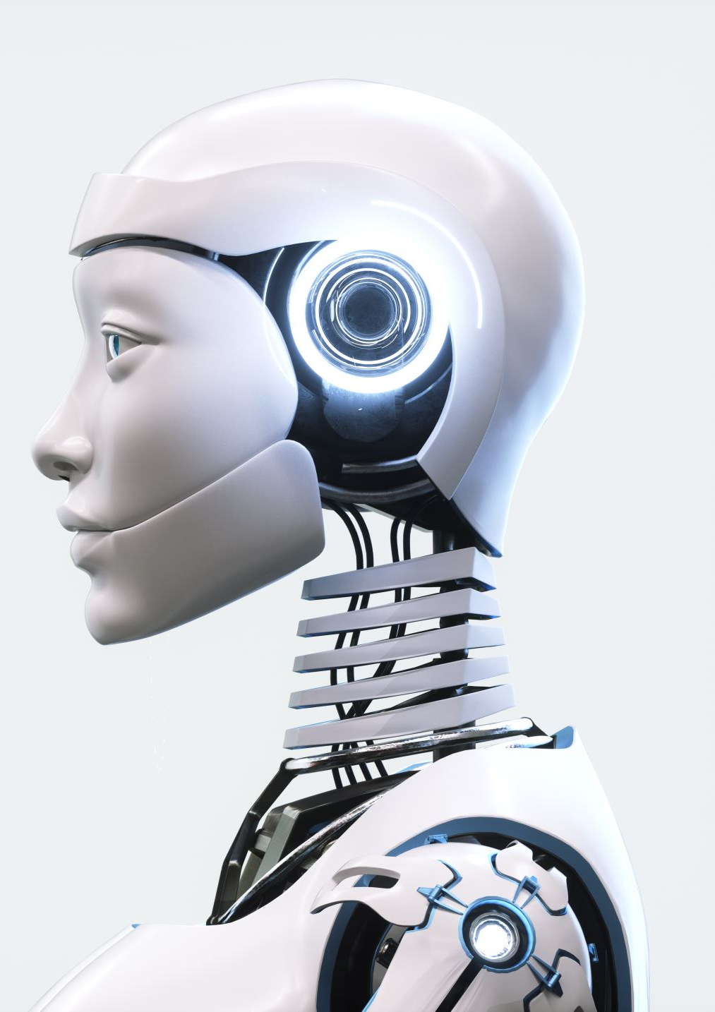
INTRODUCTION
Natural Language Processing (NLP) is a subfield of artificial intelligence that focuses on enabling machines to understand, interpret, generate, and interact using human languages. It powers technologies like:
Chatbots and virtual assistants (e.g., Siri, ChatGPT)
Machine translation (e.g., Google Translate)
Sentiment analysis, search engines, and more.

Slide 3
Challenge 1 - Ambiguity
Words or sentences can have more than one meaning.
Example: The word "bank" means a money place or a river edge.
This makes it hard for computers to know what you really mean.

Slide 4
Challenge 2 - Understanding Context
Meaning changes based on the situation or previous conversation.
Example: “She’s fine.” – Could mean okay or upset but hiding it.
Computers struggle to get these hidden meanings.

Slide 5
Challenge 3 - Sarcasm and Jokes
People often say the opposite to be funny or sarcastic.
Example: “Great, another Monday!” (really means they don’t like Mondays).
Computers usually take things literally and miss the joke.

Slide 6
Challenge 4 - Many Languages
Different languages have different rules and slang.
Some languages don’t have enough data to train computers well.
Hard to make one system work for all languages.

Slide 7
Challenge 5 - Common Sense
umans use everyday knowledge to understand sentences.
Example: “The trophy didn’t fit because it was too big.” – We know “it” is the trophy.
Computers often get confused without this knowledge.

Slide 8
CHALLENGE-6 Lack of Explainability
Deep learning models are black boxes—it’s hard to know why they gave a specific output.
Example: A model denies a loan application. Why? Was it based on the applicant’s zip code, age, or income?
In high-stakes decisions, lack of transparency is risky and can violate laws like GDPR.

Slide 9
CHALLENGE-7 Computational and Efficiency Constraints
Large language models require huge amounts of computation and memory, making them slow or expensive to run.
Example: Running GPT-4 in a smartphone app without cloud support is infeasible due to hardware limits.
This restricts NLP deployment in low-power or real-time systems.

Slide 10
CHALLENGE-8 Susceptibility to Adversarial Inputs
Minor changes in input can drastically change output, exposing vulnerabilities.
Example: "I need help with banking." → normal response "I need help with b@anking." → confusing or irrelevant response
Malicious inputs can trick models or cause them to produce unsafe responses.

Slide 11
THANK YOU

